Slide 1
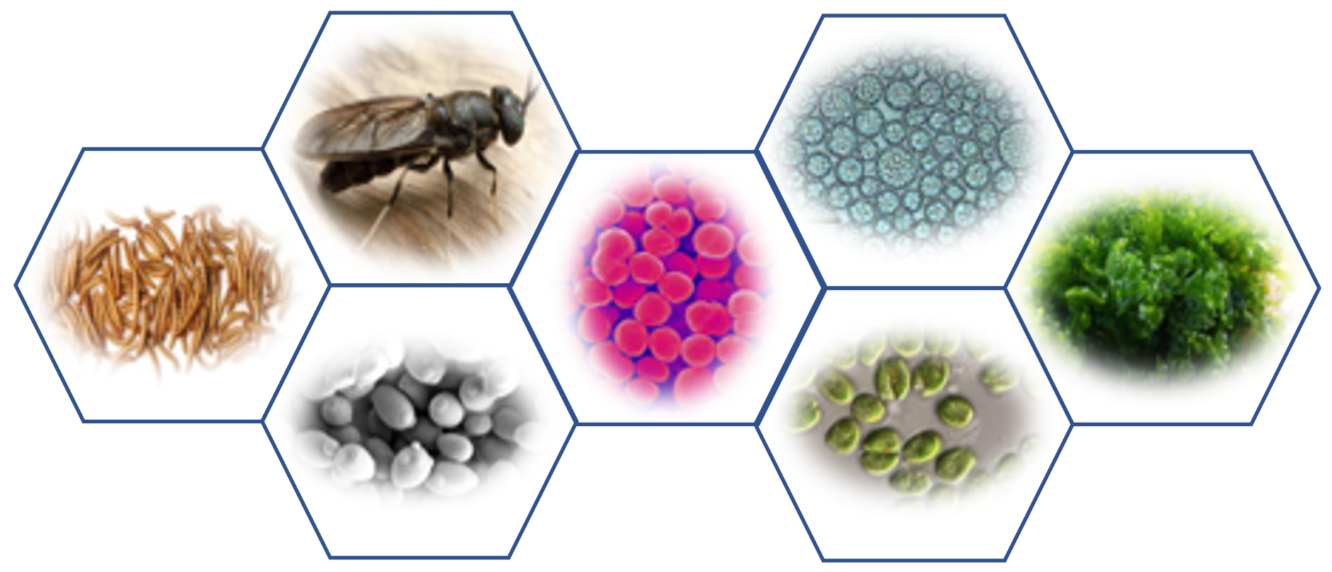
Economic and environmental sustainability decision-support tool for fish-free aquafeed
PI: Anne Kapuscinski
Co-PIs: Pallab Sarker and Elliott Campbell
Technical Lead: Brandi McKuin
HTTPS://KAPSAR.SITES.UCSC.EDU

Slide 2
Roadmap

Slide 3
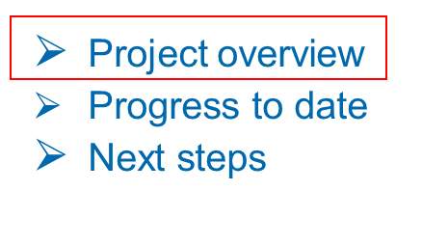
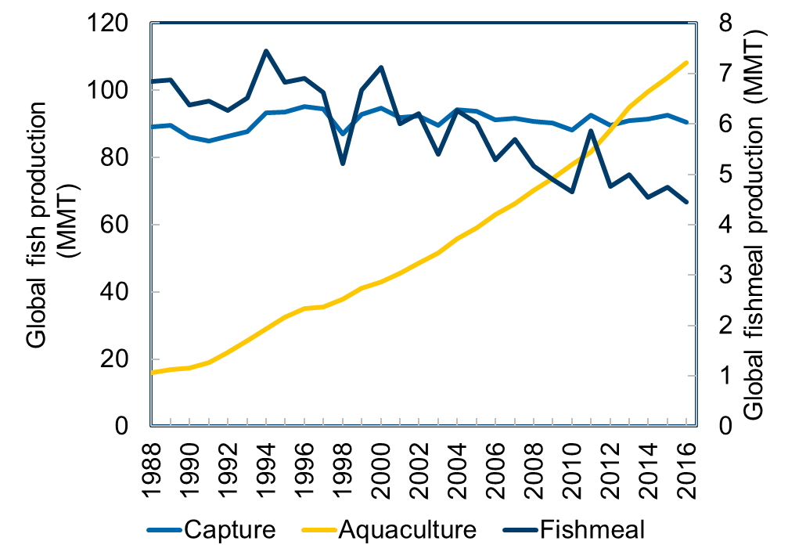
Sustainability: Business as usual

Slide 4
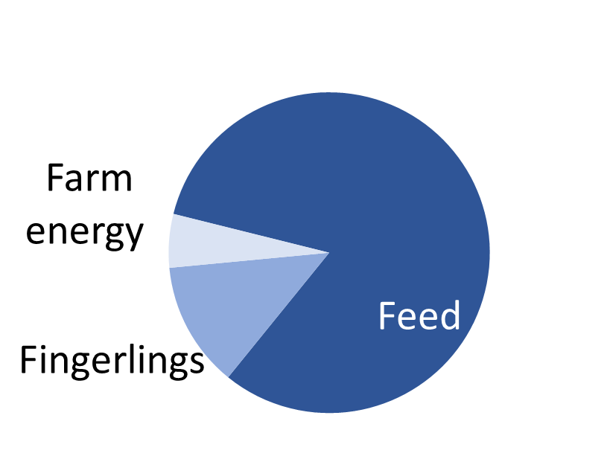
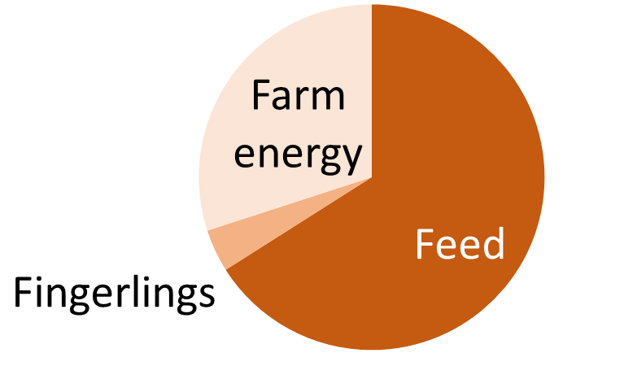
Sustainability: environmental and economic impacts of aquafeeds
Life cycle GWP
Variable costs
Life-cycle global waring potential (GWP) and variable costs of cradle-to-farm gate operations. Left panel: life-cycle GWP (Pelletier and Tyedmers, 2010). Right panel: variable costs (Ferreira et al., 2015).

Slide 5
Sustainability: Terrestrial ingredients
HOOC
3
COOH
3
CH₃
CH₃
Crop ingredients
EPA
DHA

Slide 6
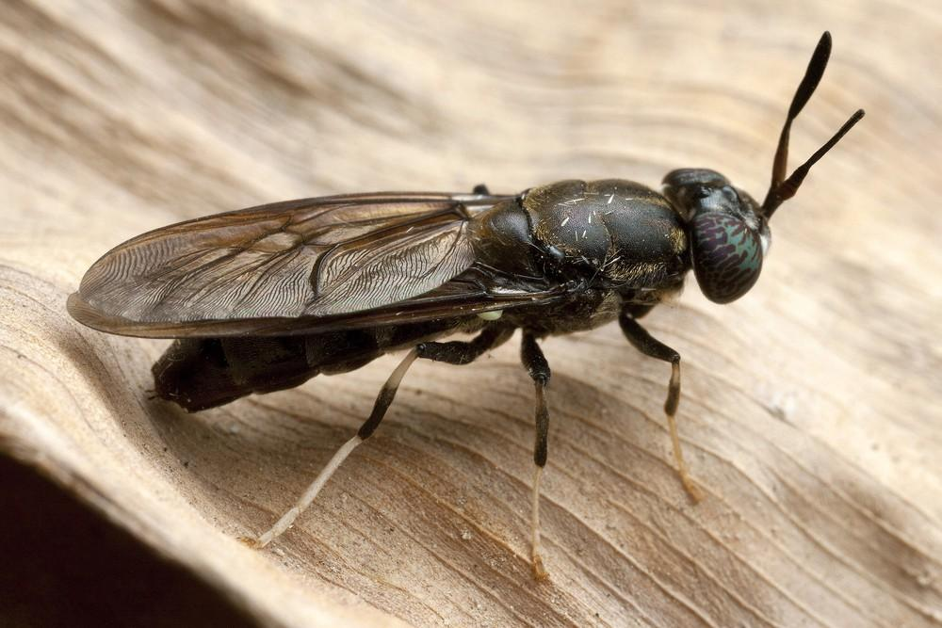
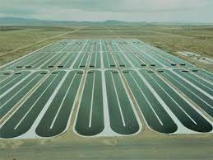
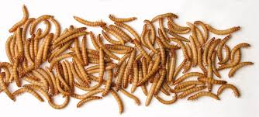
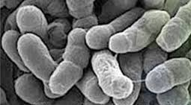
Sustainability: Alternative ingredients
Notes:
While the effect of replacing fishmeal and fish oil with conventional substitutes (e.g. soybean and corn meals and oils) has been carefully researched, the effects of alternatives sources (e.g. marine microalgae and macroalgae, single cell organisms, yeasts, and others) are largely unexplored.

Slide 7
Open-source aquafeed
decision support tool
Open source aquafeed software
Sustainable?
Aquafeed life-cycle assessment database
Graphic user interface
Techno-economic assessment database
Performance metrics database
Notes:
To address these critical knowledge gaps, we will provide an open-access decision-support tool that allows users to assess if alternative aquafeed ingredients meet nutritional requirements and promote growth of the farmed organisms, ensure high quality of the final edible product, have low environmental impact, and compete with costs of conventional aquafeed ingredients. As inputs to the decisions support tool we will develop: (1) a meta-model database of life-cycle assessments (LCA); (2) a meta-model database of techno-economic analysis (TEA) of economic performance (e.g., least cost formulations); and a (3) a meta-model database of digestibility and nutritional feeding studies. We will use linear programming with an objective function that will minimize the formulated feed cost subject to selected nutrient requirements and environmental impact constraints.

Slide 8
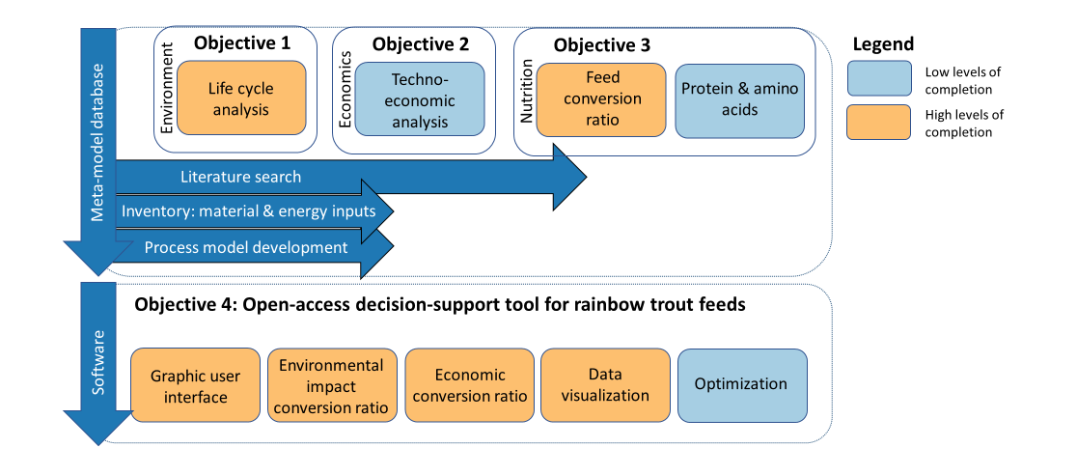
Project objectives

Slide 9
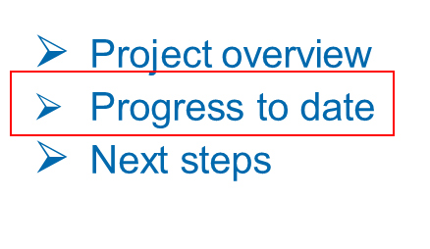
Communication with industry advisors

Slide 10
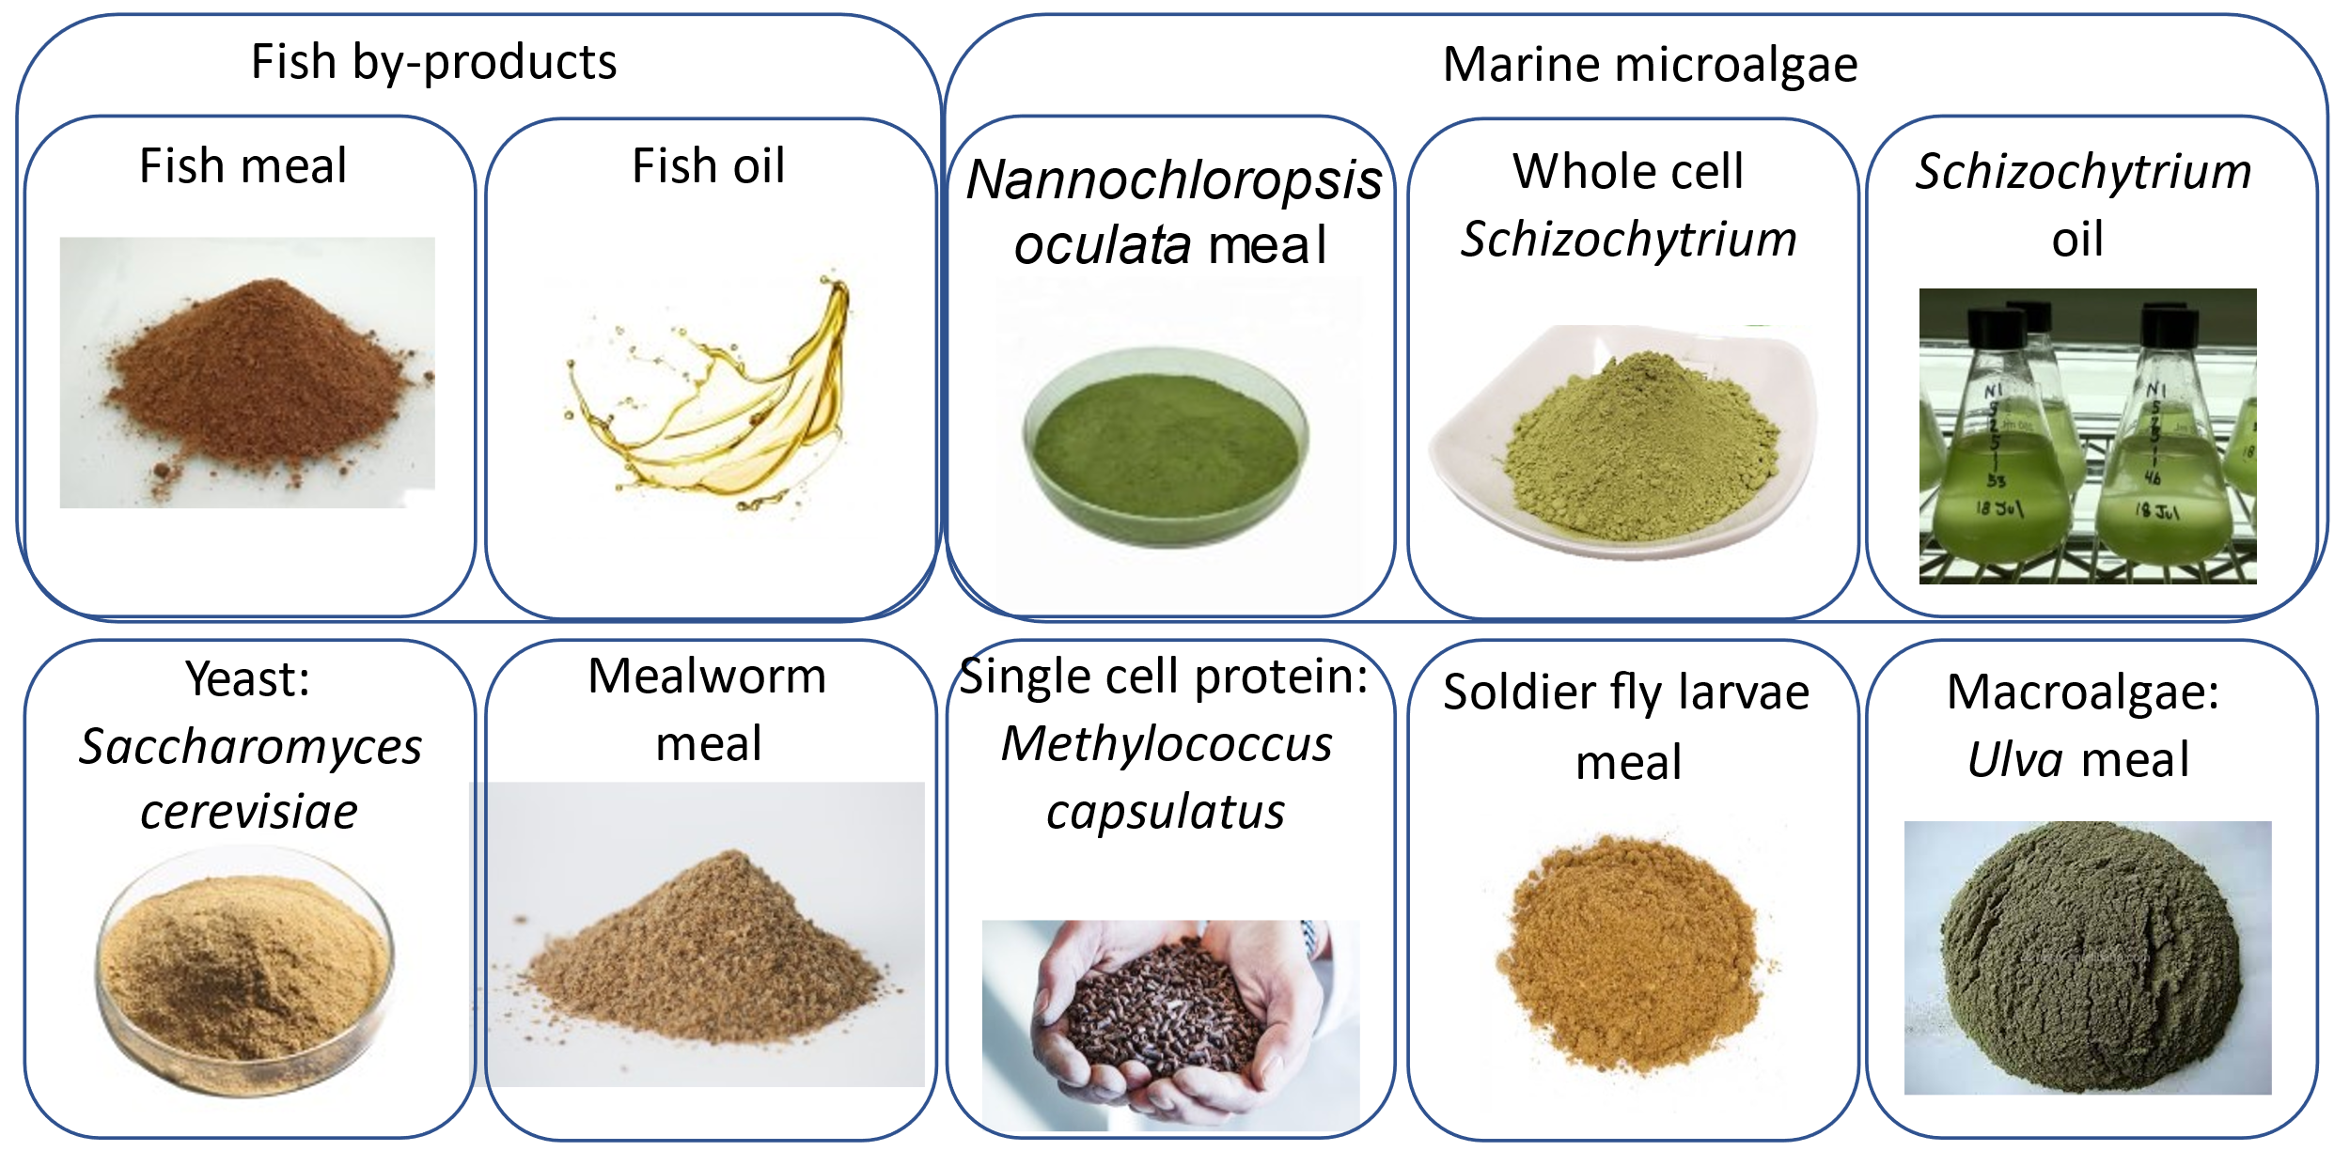
Meta-model database: Life cycle assessment
Alternative ingredients included in our analysis

Slide 11
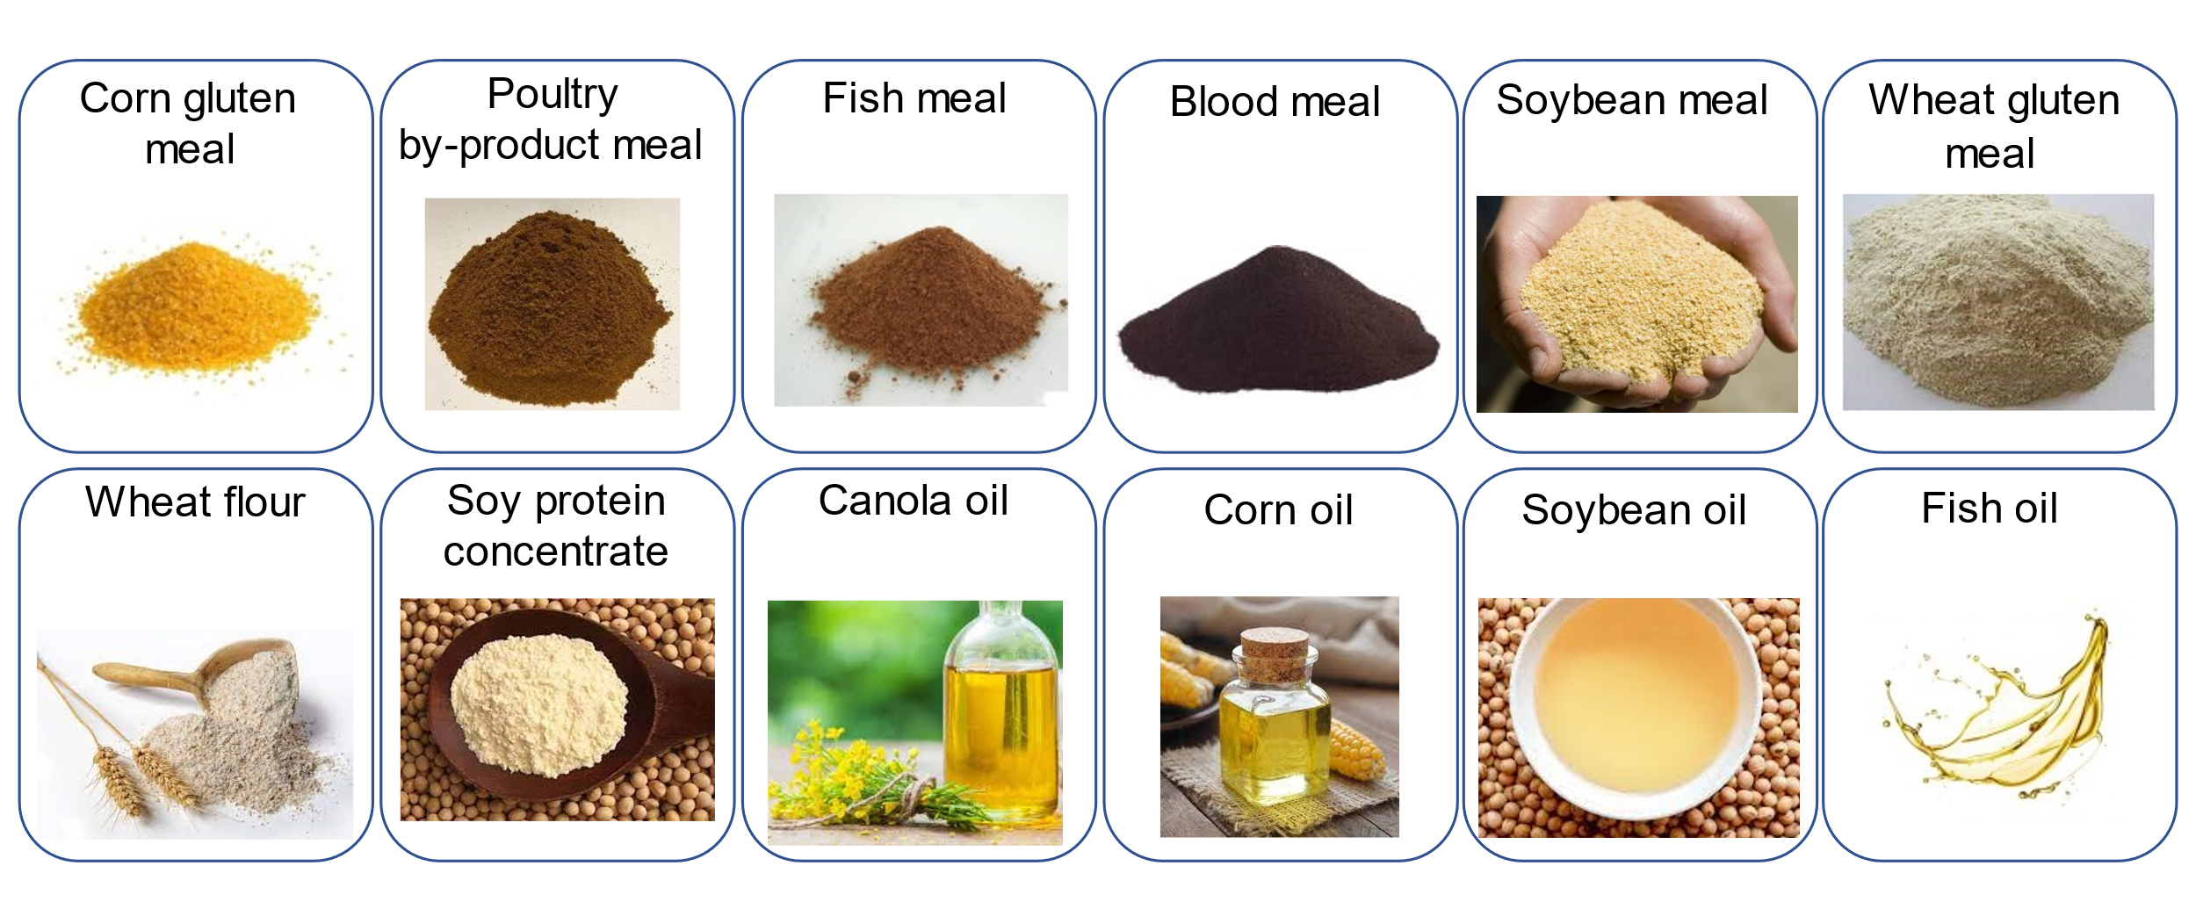
Meta-model database: Life cycle assessment
Conventional ingredients included in our analysis

Slide 12
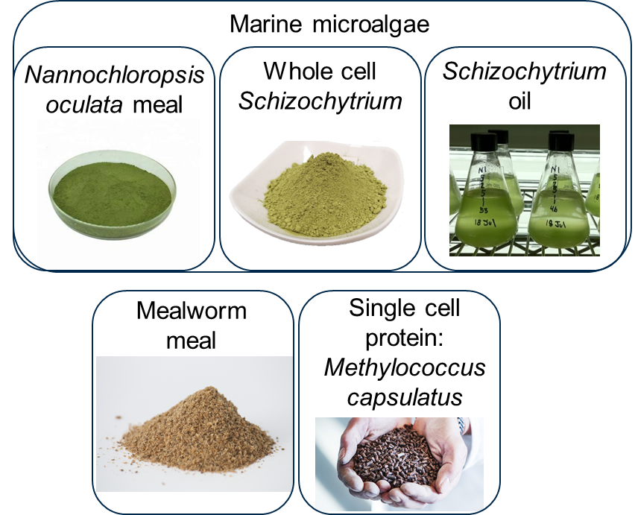
Meta-model database: Economic assessment
Alternative ingredients included in our analysis

Slide 13
Meta-model database: Economic assessment
Conventional ingredients included in our analysis

Slide 14
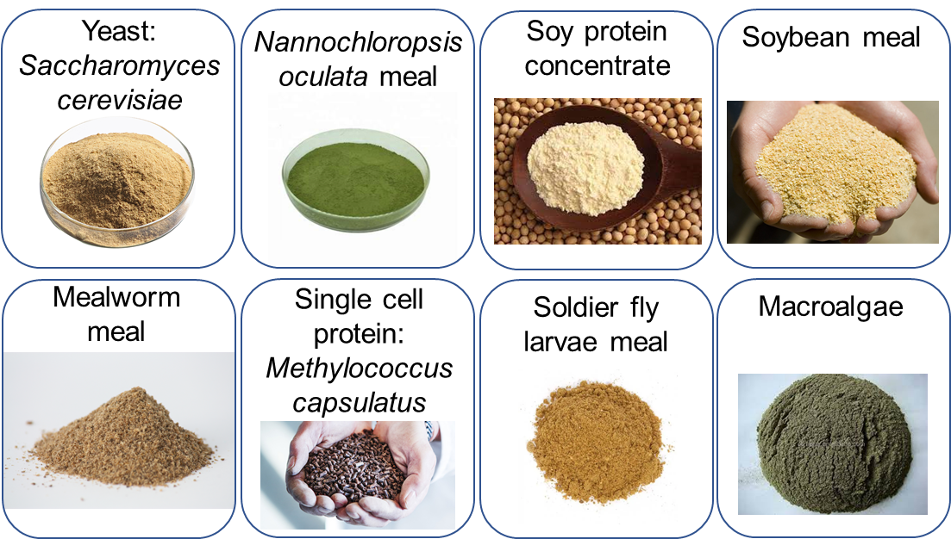
Meta-model database: Growth performance
Alternatives to fish meal included in our analysis

Slide 16
Software development
Executable file

Slide 17
Software development
Select salmonid species

Slide 18
Software development
Input feed ingredients

Slide 19
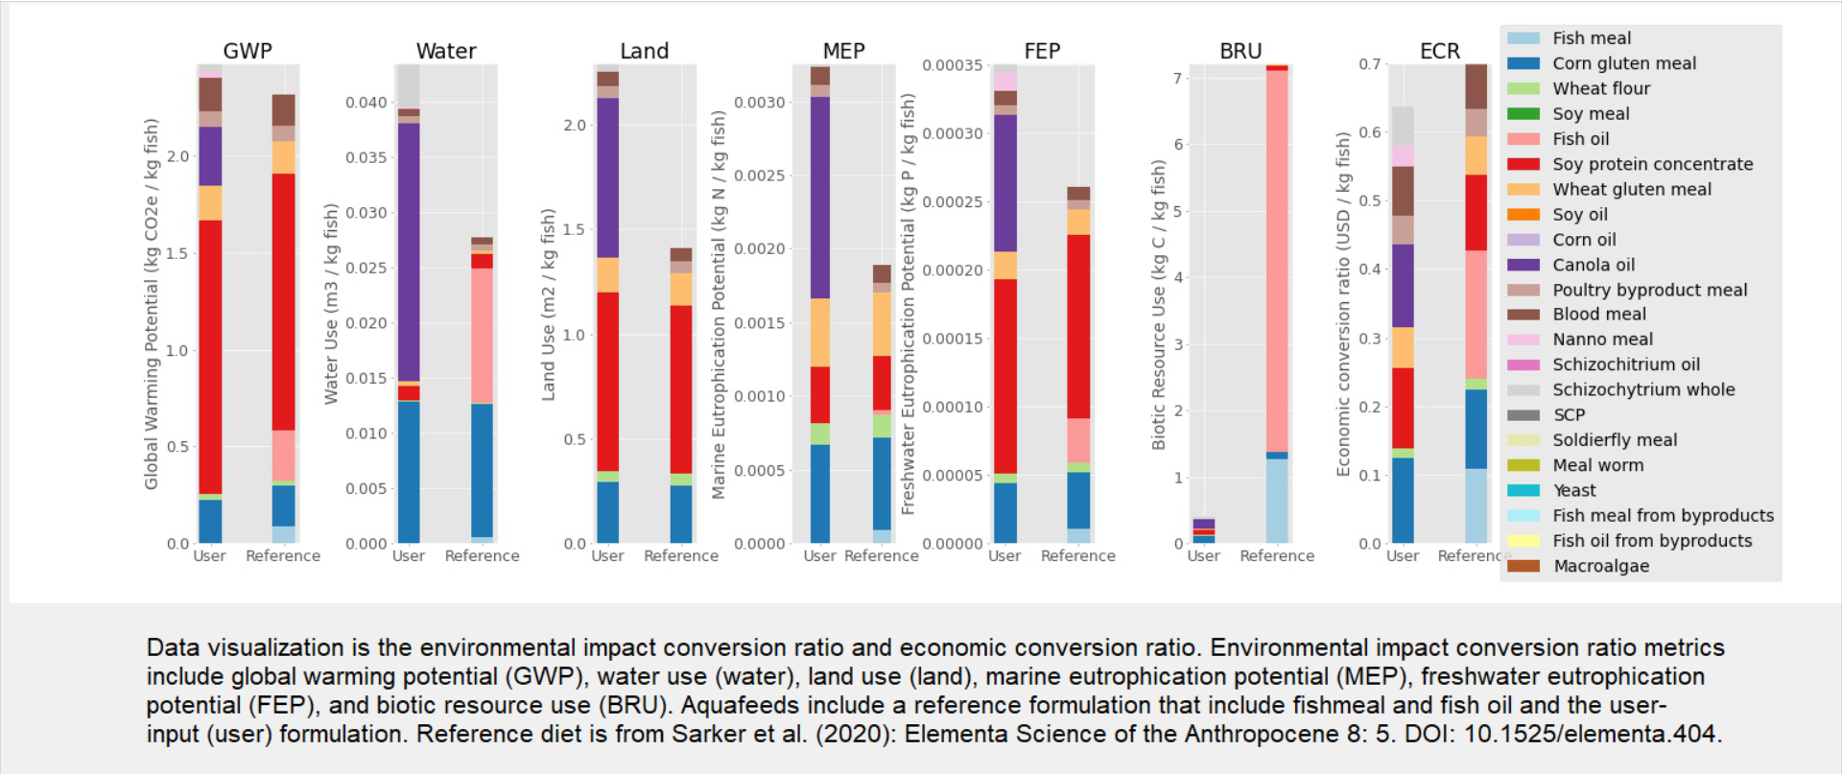
Software development

Slide 20
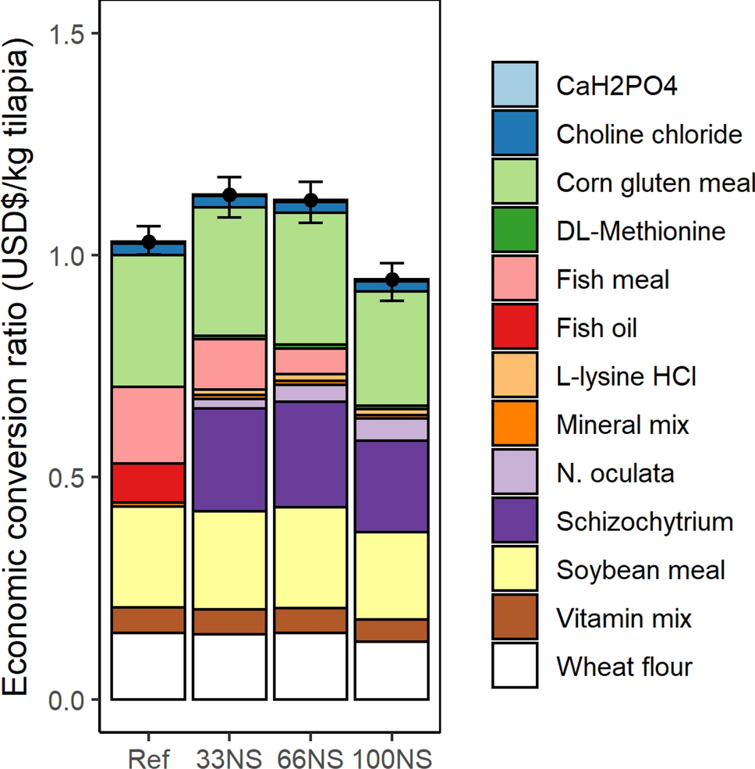
Publications

Slide 21
Publications
McKuin, B., Kapuscinski, A., Sarker, P., Cheek, N., Colwell, A, Lim, J. 2021. Meta-model database for F3Mixr: An economic and environmental sustainability decision-support tool for fish-free aquafeed. DRYAD Repository. DOI: 10.6071/M3809Z (temporary link available on request).
McKuin, B., Kapuscinski, A., Sarker, P., Schoffstall, B., & Lee, M. 2021. Software for F3Mixr: An economic and environmental sustainability decision-support tool for fish-free aquafeed. DRYAD Repository. DOI: 10.6071/M3468D (temporary link available on request).
McKuin, B., Kapuscinski, A., Sarker, P., Cheek, N., Colwell, A., Greenwood, C. 2021. Life cycle assessment of the potential of heterotrophic microalgae as sustainable fish oil replacements in aquaculture feeds. Submitted: Elementa Science of the Anthropocene.

Slide 22
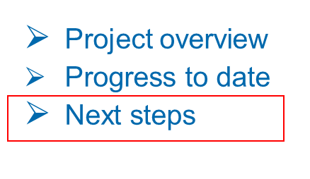
Meta-model database
Use process models used in life-cycle assessment to conduct techno-economic assessment of alternative ingredients
Add protein and amino acid data for conventional and alternative ingredients

Slide 23
Software development
Add optional open source optimization tool
Produce software user’s manual and video demonstration

Slide 24
Disseminate results
Publish life-cycle assessment of a Nannochloropsis biorefinery
Publish techno-economic analysis of Schizochytrium biorefinery
Publish techno-economic analysis of Nannochloropsis biorefinery
Publish article introducing F3 Mixr

Slide 25
Communication with industry advisors
Solicit industry feedback on software
Log feedback for future versions of software

Slide 26
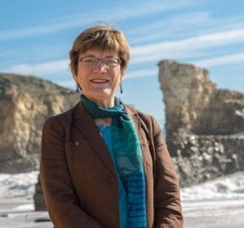
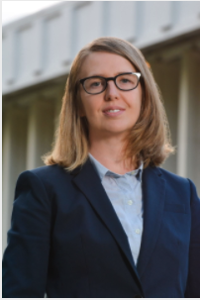
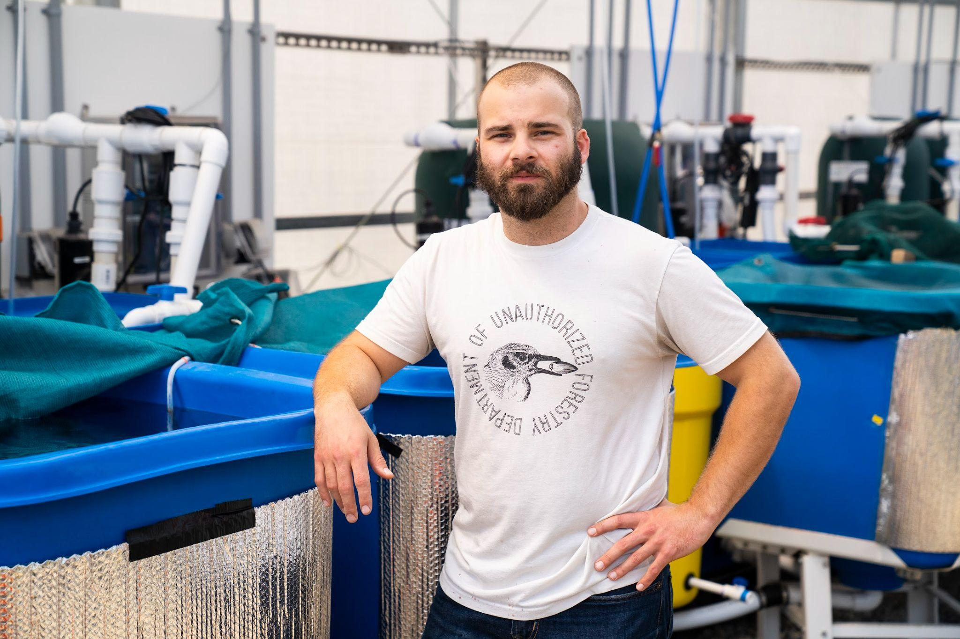
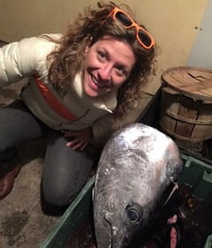
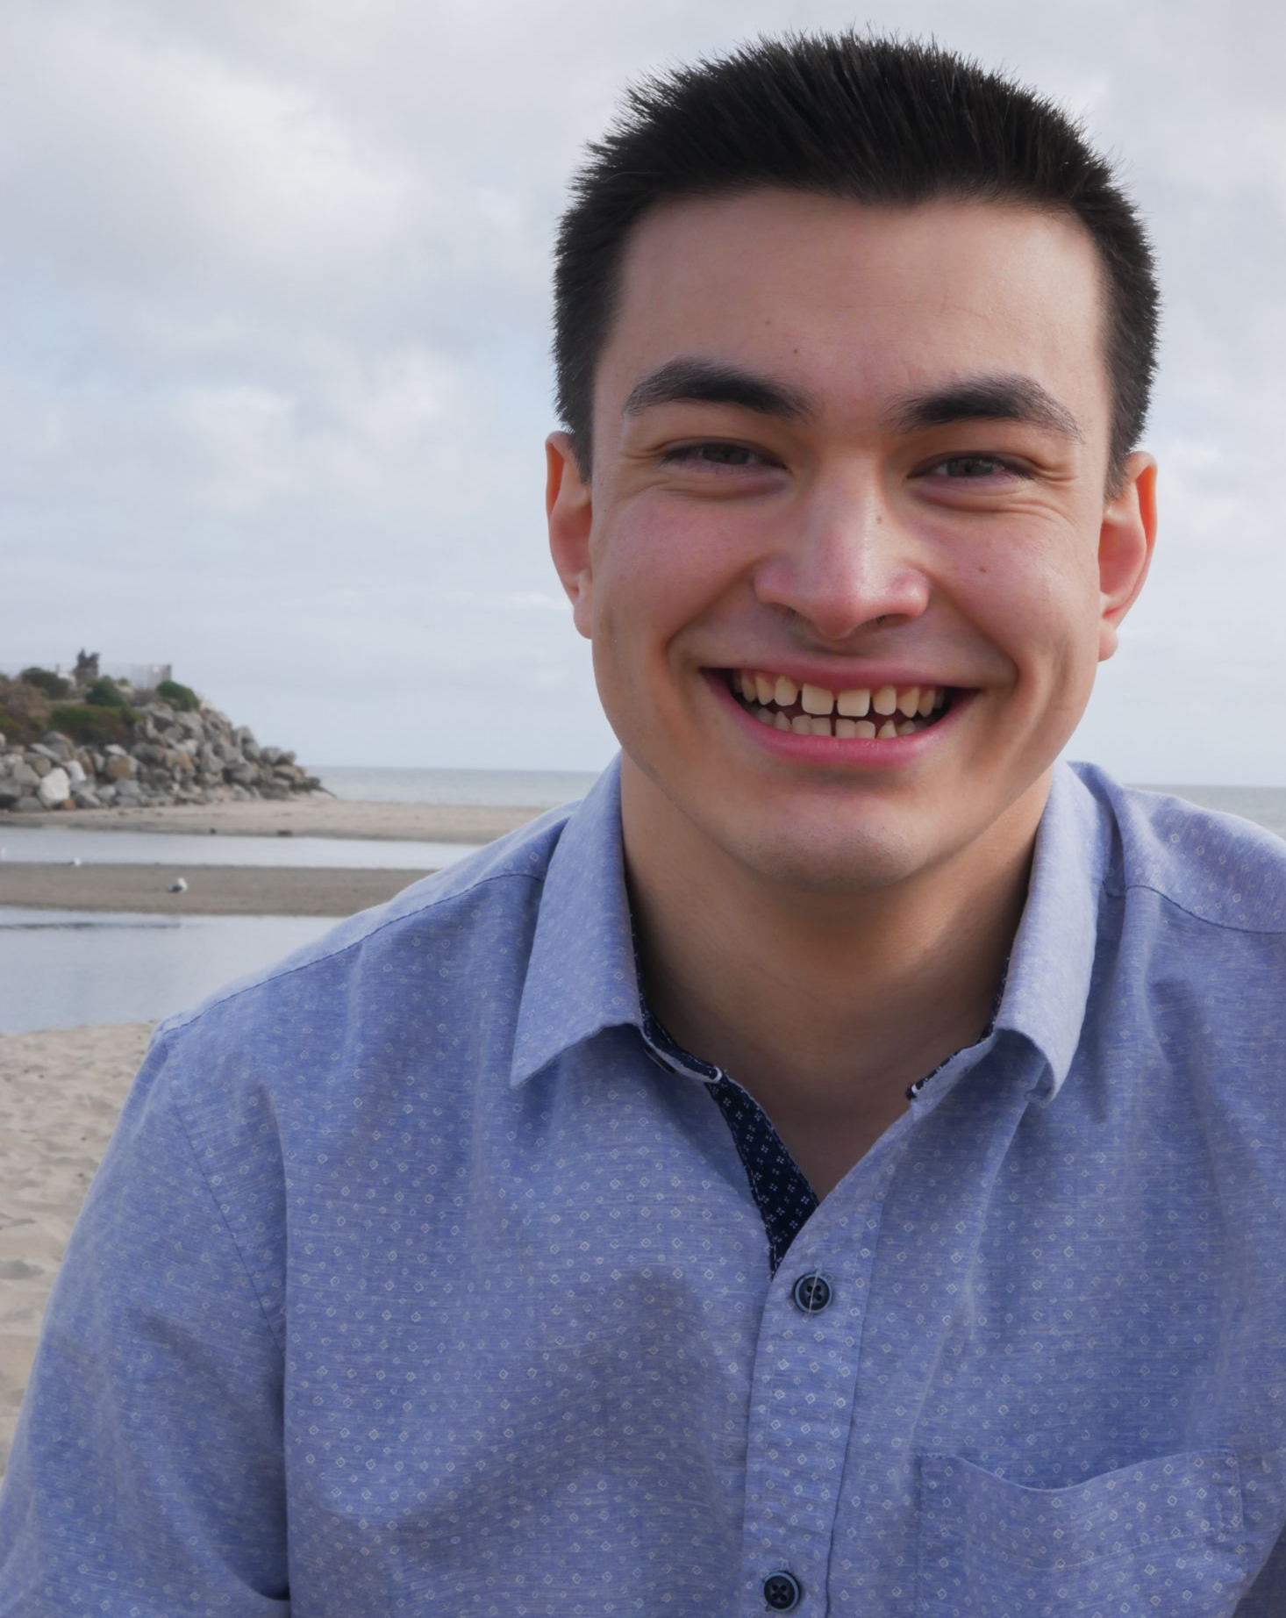
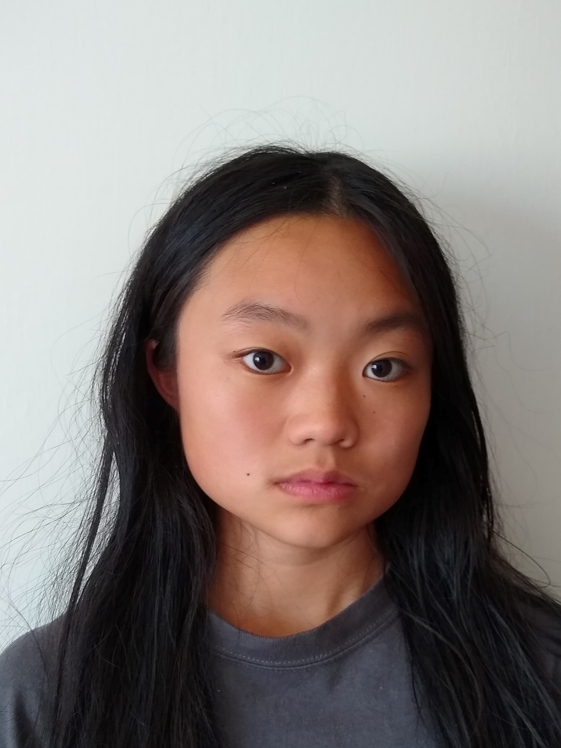
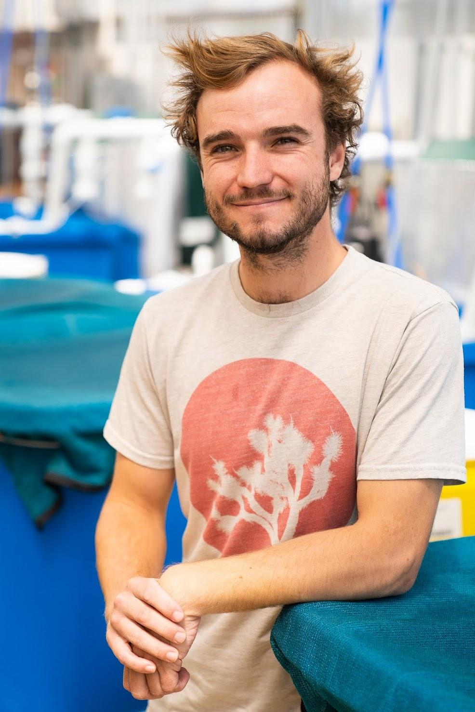
Notes:
I’d like to acknowledge the other members of the Kapuscinski-Sarker lab. Special thanks to the lead-PI of this project (and my supervisor), Anne Kapuscinski (image left), and the co-PI, Pallab Sarker (image middle top row). We have a great team.

Slide 27
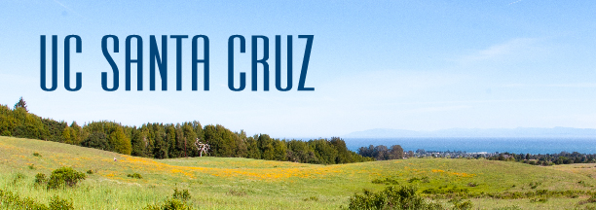
Acknowledgments
HTTPS://KAPSAR.SITES.UCSC.EDU

